Slide 1
Chapter 10:
Planning and Conducting Meetings
©2010, 2007, 2003 Pearson Education, Inc.

Slide 2
What is a Meeting?
Meeting
A scheduled gathering of group members for a structured discussion guided by a designated chairperson
©2010, 2007, 2003 Pearson Education, Inc.

Slide 3
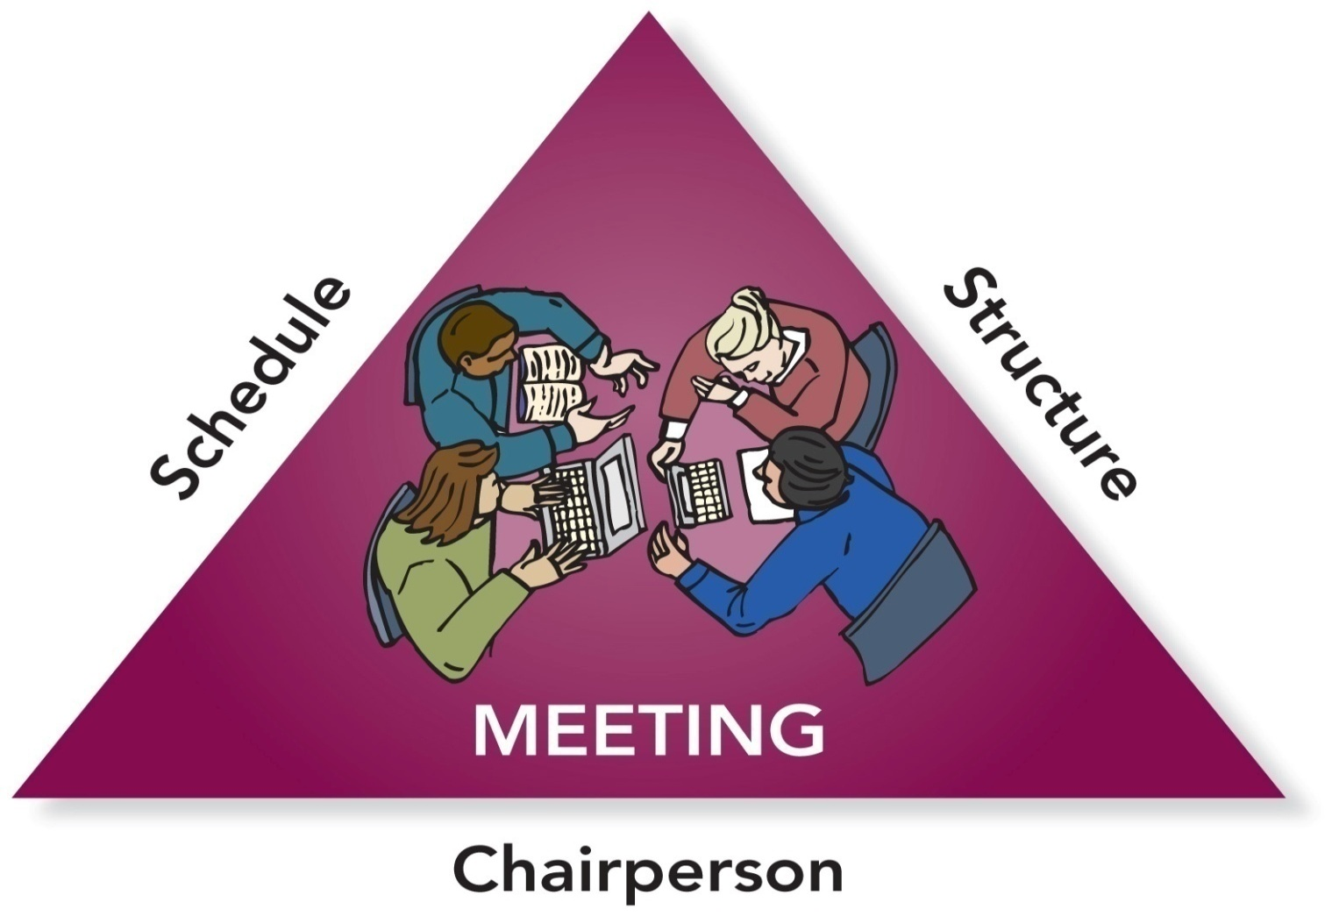
Essential Meeting Elements
©2010, 2007, 2003 Pearson Education, Inc.

Slide 4
Questions for Planning a Meeting
Why are we meeting?
Who should attend the meeting?
When should we meet?
Where should we meet?
What materials do we need?
©2010, 2007, 2003 Pearson Education, Inc.

Slide 5
PowerPoint Quiz
Which group dialectics are most relevant when planning and conducting meetings?
structure ↔ spontaneity & leadership ↔ followership.
individual goals ↔ group goals & conformity ↔ nonconformity.
heterogeneous ↔ homogeneous & conflict ↔ cohesion.
engaged ↔ disengaged & open system ↔ closed system.
©2010, 2007, 2003 Pearson Education, Inc.

Slide 6
The Need for Agendas
Agenda
The outline of items to be discussed and tasks to be accomplished during a meeting
An agenda . . .
is an organizational tool.
helps members prepare for a meeting.
is a time management tool.
provides a measure of success.
©2010, 2007, 2003 Pearson Education, Inc.

Slide 7
A Business Meeting Agenda
Purpose of Meeting
Names of Group Members—present or absent
Date, Time, and Place
Call to Order
Approval of the Agenda
Approval of Previous Meeting’s Minutes
Individual and Committee Reports
Unfinished Business
New Business
Announcements
Adjournment
©2010, 2007, 2003 Pearson Education, Inc.

Slide 8
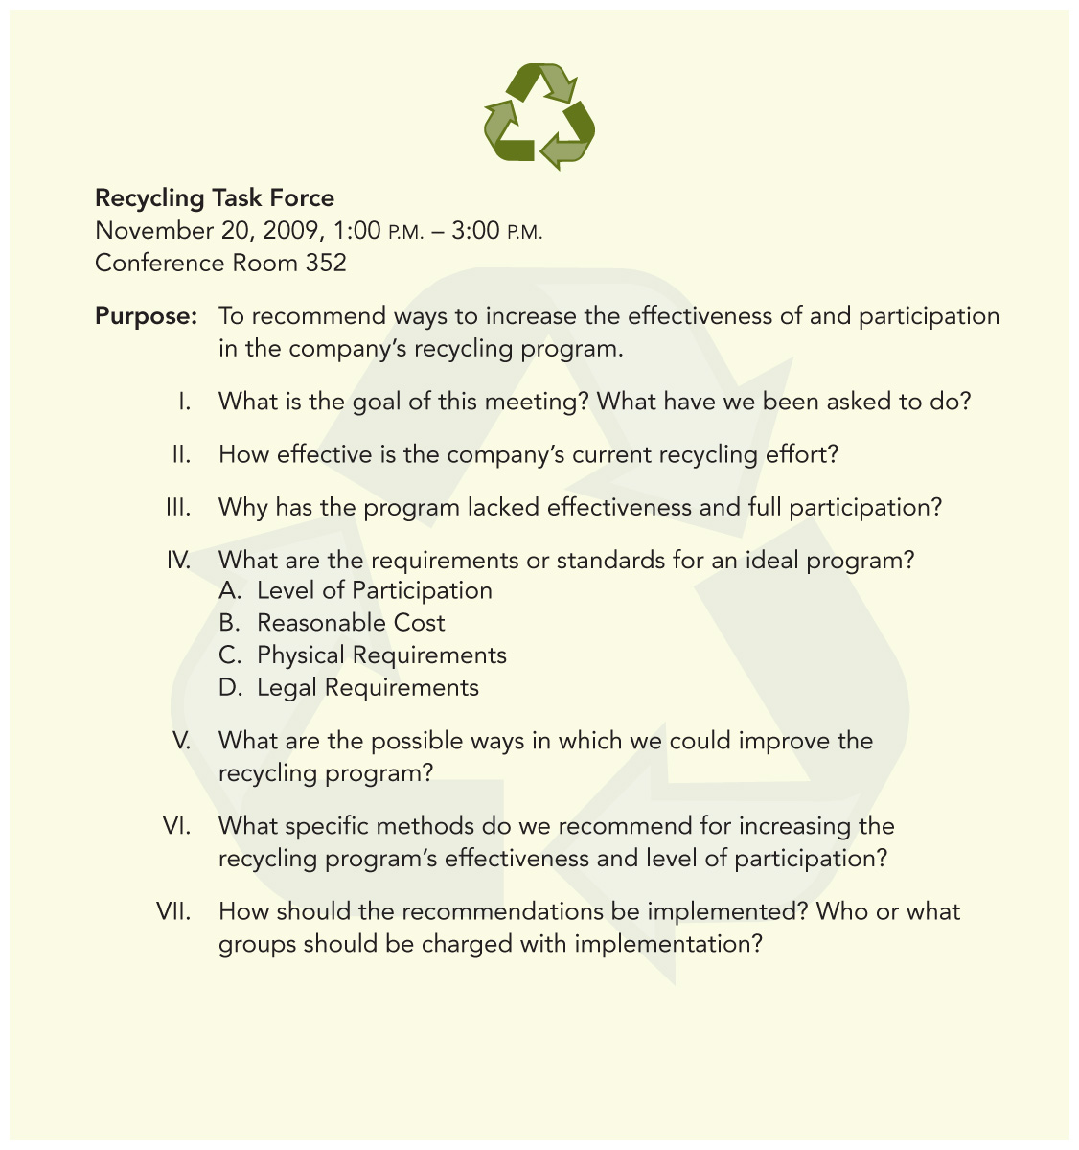
Sample
Discussion
Agenda
©2010, 2007, 2003 Pearson Education, Inc.

Slide 9
PowerPoint Quiz
When is the best time to address important and difficult issues in a meeting?
  At the beginning of the meeting
  During the middle portion of the meeting
  During the last third of the meeting
  At the end of the meeting
©2010, 2007, 2003 Pearson Education, Inc.

Slide 10
Chairperson’s Pre-Meeting Tasks
Notify members
Distribute materials
Remind members
Prepare for discussion
©2010, 2007, 2003 Pearson Education, Inc.

Slide 11
Chairperson’s Tasks
During the Meeting
  Begin on time
  Delegate meeting minutes
  Follow the agenda
  Facilitate the discussion
  Provide closure
©2010, 2007, 2003 Pearson Education, Inc.

Slide 12
Chairperson’s Post-Meeting Tasks
  Evaluate the meeting
  Distribute the meeting minutes
  Monitor assigned tasks
©2010, 2007, 2003 Pearson Education, Inc.

Slide 13
Common Disruptive Behaviors
Nonparticipants
Loudmouths
Interrupters
Whisperers
Latecomers
Early Leavers
©2010, 2007, 2003 Pearson Education, Inc.

Slide 14
Dealing with Loudmouths
How to deal with loudmouths:
Acknowledge that you understand their positions.
Interrupt them and shift the focus to other members.
Tell them the group needs input from everyone.
Assign them side-line tasks (e.g., taking minutes) that shift them from talking to listening and writing.
©2010, 2007, 2003 Pearson Education, Inc.

Slide 15
How to Deal with Disruptive Behavioral Problems
Nonparticipants: _______________________________________________________________________________________
Interrupters: ________________________________________________________________________________________
Whisperers: ________________________________________________________________________________________
Latecomers and Early Leavers: ________________________________________________________________________________________
©2010, 2007, 2003 Pearson Education, Inc.

Slide 16
PowerPoint Quiz
If members are frequently late to meetings, the chairperson should . . .
wait to start until all members have arrived.
review what has been accomplished whenever a latecomer arrives.
let latecomers sit without participating
publicly reprimand latecomers.
assign latecomers tasks that he/she can/wants to do.
©2010, 2007, 2003 Pearson Education, Inc.

Slide 17
PowerPoint Quiz
If members are frequently late to meetings, the chairperson should . . .
wait to start until all members have arrived.
review what has been accomplished whenever a latecomer arrives.
let latecomers sit without participating until they have observed enough to be able to contribute.
publicly reprimand latecomers.
assign latecomers tasks that no one else wants to do
©2010, 2007, 2003 Pearson Education, Inc.

Slide 18
PowerPoint Quiz
In order to run a successful virtual meeting, you should. . .
  begin a virtual meeting by reading the meeting agenda out loud.
  invite more people to participate.
  make sure that all members have access to the technology and know how to use it.
  use technology you’ve used before so you don’t have to worry about testing it prior to meeting with the group.
  Deborah Duarte and Nancy Snyder, Mastering Virtual Teams
©2010, 2007, 2003 Pearson Education, Inc.

Slide 19
Preparing the Minutes
The minutes of a meeting are . . .
the written record of a group’s discussion and activities.
legal documents as well as historical records of organization business.
a way to share what happens with members who don’t attend.
a way to prevent disagreement over member assignments and group decisions.
©2010, 2007, 2003 Pearson Education, Inc.

Slide 20
What to Include in the Minutes
Name of the group
Date and place of meeting
Names of attending members
Name of the chair
Names of absent members
Time the meeting was called to order
Time the meeting adjourned
Name of person preparing the minutes
Summary of discussion and decisions including action items
©2010, 2007, 2003 Pearson Education, Inc.

Slide 21
Taking Minutes
Write clear statements that summarize the meeting’s main ideas and actions.
Word decisions, motions, action items, and deadlines exactly as the group makes them.
If in doubt, ask the group for clarification.
Attach the agenda and any reports to the final copy of the minutes.
©2010, 2007, 2003 Pearson Education, Inc.

Slide 22
Guidelines for Taking Minutes
Report the facts and all sides of a discussion accurately.
_________________________________
_________________________________
_________________________________
Always keep in mind that the minutes are a public record of the meeting.
©2010, 2007, 2003 Pearson Education, Inc.

Slide 23
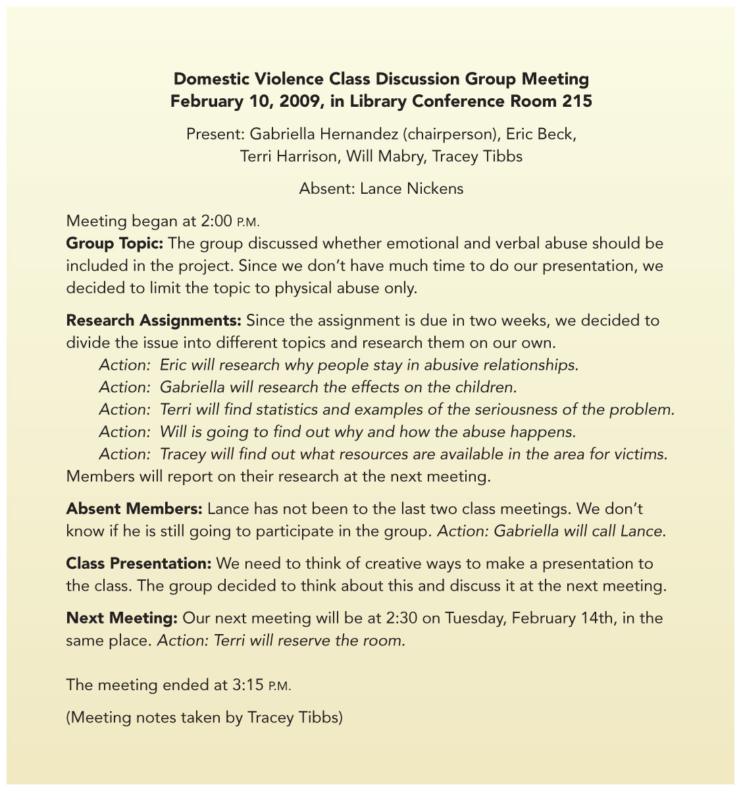
Sample of
Informal
Minutes
©2010, 2007, 2003 Pearson Education, Inc.

Slide 24
Parliamentary Procedure
A set of formal rules used to determine the will of the majority through fair and orderly discussion and debate
Purpose of parliamentary procedure:
To protect the rights of minority members while ensuring majority rule
©2010, 2007, 2003 Pearson Education, Inc.

Slide 25
Basic Principles of
Parliamentary Procedure
Majority Will
Minority Rights
Balanced Discussion
Orderly Progress
©2010, 2007, 2003 Pearson Education, Inc.

Slide 26
Passing a Main Motion
Make the motion. Present a proposal to the group: “I move that we go to lunch.”
Second the motion. A main motion must be seconded .“I second the motion.”
Amend the motion. A main motion can be amended: “I move that we go to lunch at 12:30 pm.”
Voting. The group decides whether to accept or reject the motion: “All those in favor say aye. All those opposed say nay.”
©2010, 2007, 2003 Pearson Education, Inc.

Slide 27
Post-Meeting Evaluation
Was the meeting’s goal clear?
Was the agenda useful and followed?
How prepared were group members?
Did everyone have an equal chance to participate?
Did members listen effectively and consider different points of view?
Were assignments and deadlines made clear by the end of the meeting?
©2010, 2007, 2003 Pearson Education, Inc.

